Slide 1
Chapter 7A
Zoroastrianism

Slide 2
Learning Objectives
7A.1 Describe the life and teachings of Zarathushtra.
7A.2 Identify the key texts of Zoroastrianism.
7A.3 Summarize the main Zoroastrian rituals.
7A.4 Discuss Zoroastrianism in the modern world.

Slide 3
Zoroastrianism Introduction
Zoroastrianism originated in ancient Iran and for some of its history may have been practiced from the Iraq/ Turkey region to India, thus making it a sort of “bridge.”
For more than 1,000 years, Zoroastrianism may have been the official religion of the vast Iranian Empire that stretched from Iraq to Turkey or India.
It shares many concepts with Vedic Hinduism, and it is possible that the monotheistic thought that developed in Zoroastrianism influenced other faiths.
Today, it has perhaps only 124,000 to 190,000 practitioners.

Slide 4
7A.1 Zarathushtra’s mission
This native religion of Iran was named after one of its reformers, Zarathushtra (Greek: Zoroaster); in Iran, it is known as Mazdayasna.
Although the exact dates of Zarathushtra’s life are not known, he may have lived sometime between 1800 and 1500 BCE in Central Asia.
The Greeks in the time of Plato referred to him as an ancient prophet.
Zarathushtra was apparently trained as a priest in the Indo-Iranian tradition.

Slide 5
Zoroastrianism today
Where is Zoroastrianism still practiced today?
Yazd
Central area for Zoroastrianism in Iran
Holy flame burning for 1,500 years
Burial rites must be conducted in Mumbai, India
Muslims converted to Zoroastrianism during Pahlavi dynasty (1925–1979)
Notes:
Few followers remain of this ancient way of combating evil with personal goodness. The number of Zoroastrians is falling toward possible extinction. In Yazd, the central area where Zoroastrianism is still practiced in Iran, a holy flame has been burning continuously for 1,500 years, but there are not enough devotees to keep a Tower of Silence open. If a Zoroastrian living in Iran wants traditional burial rites, the body must be shipped to Mumbai in India, where the last Tower of Silence is still operating. But Zoroastrian pilgrims from around the world still visit sacred shrines in Yazd.
Conversion to the faith is not emphasized, partly because of a desire not to dilute the teachings or the identity as a distinct faith community. In contemporary Iran, there is little incentive to convert, since Zoroastrians, like Jewsand Christians, are tolerated but limited in their privileges under Muslim rule. Historically, however, many Muslims converted to Zoroastrianism during the last years of the Pahlavi dynasty (1925–79). Some Zoroastrians in North America favor active conversion of non-Zoroastrians to the faith; others are opposed to proselytizing but favor the acceptance of those who are truly moved by personal religious experience. In India, the high priests of the Mumbai Zoroastrian community declared in 2003 that anyone marrying outside the religion would be excommunicated, but this brought such an outcry that they clarified that their statement was only a “guideline” to assure the survival of the Parsi faith. However, late marriage, low birth rates, and divorce remain concerns as the Parsi population continues to decline.

Slide 6

Zoroastrianism today
Where is Zoroastrianism still practiced today?
Burial rites must be conducted in Mumbai, India
5 Towers of Silence
Notes:
Few followers remain of this ancient way of combating evil with personal goodness. The number of Zoroastrians is falling toward possible extinction. In Yazd, the central area where Zoroastrianism is still practiced in Iran, a holy flame has been burning continuously for 1,500 years, but there are not enough devotees to keep a Tower of Silence open. If a Zoroastrian living in Iran wants traditional burial rites, the body must be shipped to Mumbai in India, where the last Tower of Silence is still operating. But Zoroastrian pilgrims from around the world still visit sacred shrines in Yazd.
Conversion to the faith is not emphasized, partly because of a desire not to dilute the teachings or the identity as a distinct faith community. In contemporary Iran, there is little incentive to convert, since Zoroastrians, like Jewsand Christians, are tolerated but limited in their privileges under Muslim rule. Historically, however, many Muslims converted to Zoroastrianism during the last years of the Pahlavi dynasty (1925–79). Some Zoroastrians in North America favor active conversion of non-Zoroastrians to the faith; others are opposed to proselytizing but favor the acceptance of those who are truly moved by personal religious experience. In India, the high priests of the Mumbai Zoroastrian community declared in 2003 that anyone marrying outside the religion would be excommunicated, but this brought such an outcry that they clarified that their statement was only a “guideline” to assure the survival of the Parsi faith. However, late marriage, low birth rates, and divorce remain concerns as the Parsi population continues to decline.

Slide 7

Zoroastrianism today
Where is Zoroastrianism still practiced today?
Yazd
Central area for Zoroastrianism in Iran
Holy flame burning for 1,500 years
A Zoroastrian priest adds wood to the Atash Bahram (Fire of Victory) in the sanctum at the Fire Temple of Yazd in central Iran on July 4.
Notes:
Few followers remain of this ancient way of combating evil with personal goodness. The number of Zoroastrians is falling toward possible extinction. In Yazd, the central area where Zoroastrianism is still practiced in Iran, a holy flame has been burning continuously for 1,500 years, but there are not enough devotees to keep a Tower of Silence open. If a Zoroastrian living in Iran wants traditional burial rites, the body must be shipped to Mumbai in India, where the last Tower of Silence is still operating. But Zoroastrian pilgrims from around the world still visit sacred shrines in Yazd.
Conversion to the faith is not emphasized, partly because of a desire not to dilute the teachings or the identity as a distinct faith community. In contemporary Iran, there is little incentive to convert, since Zoroastrians, like Jewsand Christians, are tolerated but limited in their privileges under Muslim rule. Historically, however, many Muslims converted to Zoroastrianism during the last years of the Pahlavi dynasty (1925–79). Some Zoroastrians in North America favor active conversion of non-Zoroastrians to the faith; others are opposed to proselytizing but favor the acceptance of those who are truly moved by personal religious experience. In India, the high priests of the Mumbai Zoroastrian community declared in 2003 that anyone marrying outside the religion would be excommunicated, but this brought such an outcry that they clarified that their statement was only a “guideline” to assure the survival of the Parsi faith. However, late marriage, low birth rates, and divorce remain concerns as the Parsi population continues to decline.

Slide 8
Zoroastrian teachings
What are the important rituals in Zoroastrianism?
After Zarathushtra’s death: teachings merged with earlier polytheistic trends
Today:
Uncertainty about what he taught
Enough is known

Slide 9
7A.1 Zarathushtra’s mission
Zarathushtra experienced communion with the lord Ahura Mazda (the creator god) and taught that Ahura Mazda was the supreme lord (as opposed to the many deities worshiped in Indo-Iranian tradition).
Zarathushtra spoke of a cosmic battle between sustaining and destroying forces in the world and taught that Ahura Mazda created only goodness.

Slide 10
7A.1 Zarathushtra’s mission
Zarathushtra composed metric verses called Gathas, which are linguistically and thematically linked to the Rig Veda.
This new religion did not catch on until King Vishtapa adopted Zarathushtra’s creed and proclaimed Zoroastrian as the state religion.

Slide 11
7A.1 Zarathushtra’s mission
Zoroastrianism, one of the oldest world religions, originated in the second millennium BCE among Iranian tribes in Central Asia
Called Zoroastrianism in the West, after the Greek form Zoroaster for Avestan Zarathushtra (here: Zarathustra)
Also Mazdaism after Ahura Mazda, their supreme god
Later, after they moved south onto the Iranian Plateau, this religion became that of three great Iranian empires:
the Achaemenids (550–330 BCE)
the Arsacids/Parthians (247 BCE–224 CE)
the Sasanians (224–650)
No longer a state religion after the Arab conquest of Iran

Slide 12
7A.1 Zarathushtra’s Mission
Mazdayasna: “the worship of Ahura Mazda”
Zarathushtra, the prophet (some time c. 1800–1500 BCE)
Mystical seeker; spent many years on spiritual retreat
At 30, he had a vision of a shining being, Vohu Manah
Experienced communion with Ahura Mazda, creator god
Composed Gathas, hymns in adoration of Ahura Mazda
Zarathushtra is said to have preached for almost fifty years until his death by assassination at a fire temple at the age of seventy-seven.
Notes:
in the time of Plato mentioned him as an ancient prophet. It is thought that Zarathushtra was trained as a priest in the Indo-Iranian tradition. He was also apparently a mystical seeker who spent many years in spiritual retreat. At the age of thirty, he is said to have had a stunning vision of a great shining being, Vohu Manah, the embodiment of the good mind. Vohu Manah led him into the presence of Ahura Mazda, the creator god.

Slide 13
7A.1 Zarathushtra’s Mission
Zarathushtra poured forth his adoration for the Supreme in metric verses called Gathas.
These hymns are the only words of the prophet that have been retained over centuries of vicissitudes.
“Speak to me as friend to friend,” he implores Ahura Mazda.”
“Grant us the support which friend would give to friend.”
The Gathas are the major existing source of information about Zarathushtra’s life and theology, but they are written in an ancient language whose meanings are now obscure. Scholars see linguistic and thematic links between the Gathas and the earliest Vedas.

Slide 14
7A.2 Spread of Zoroastrian beliefs
It is difficult to trace the spread of Zarathushtra’s ideas, but it may be linked to the priestly specialists from western Iran known as the Magi.
Under the Persian Empire established in the mid-sixth century BCE, Zoroastrian beliefs—such as the belief that there is an evil aspect in life, an immortal soul, reward or punishment in an afterlife, and bodily resurrection at the apocalyptic end of the present age—may have influenced the Jewish people in the region and perhaps from there indirectly passed into Christianity and Islam.

Slide 15
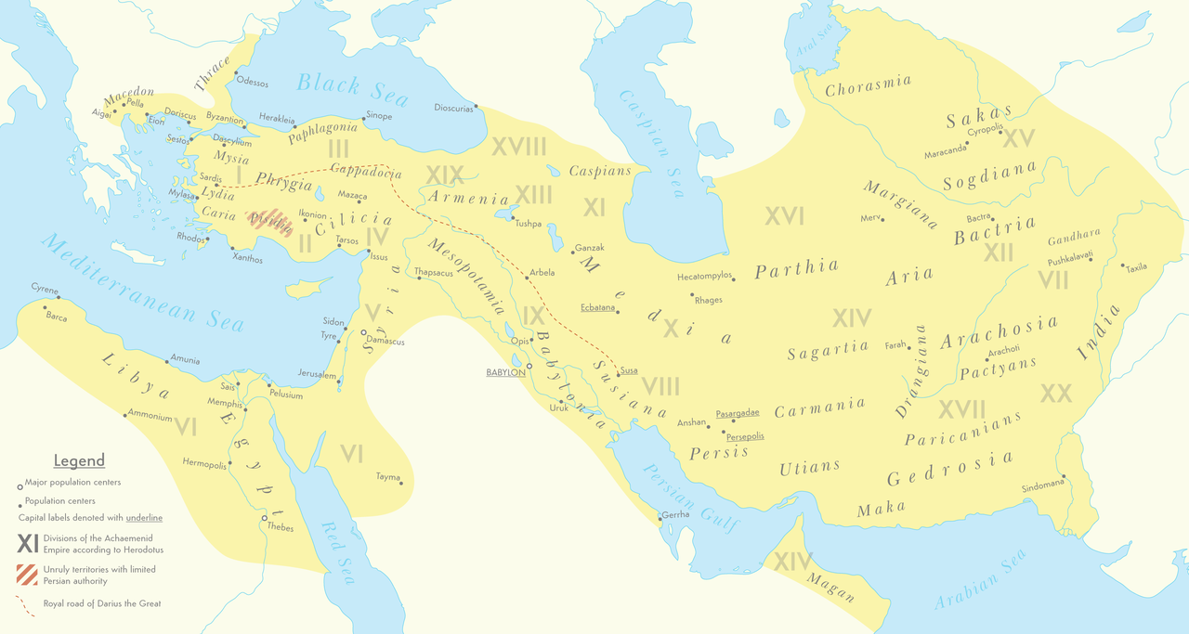
Achaemenid Empire (550 BC–330 BC)
Notes:
/əˈkēmənəd/

Slide 16
7A.2 Spread of Zoroastrian beliefs
Magi: priestly tribe
Ahura Mazda worshiped by Achaemenid kings of Persian Empire
King Cyrus’s reign
Mid-sixth century BCE
Religious tolerance
Possible Zoroastrian influence on Judaism
Evil aspect of life
Immortal soul
Reward and punishment in afterlife
Final resurrection
Notes:
Zarathushtra poured forth his adoration for the Supreme in metric verses called Gathas. These hymns are the only words of the prophet that have been retained over centuries of vicissitudes.
tribe of priestly specialists in western Iran whose practices included magic and astrology—seem to have become involved with transmission of Zoroastrianism some time after Zarathushtra died ALTERED IT?
Book of Matthew
“Speak to me as friend to friend,” he implores Ahura Mazda. “Grant us the support which friend would give to friend.”1 The Gathas are the major existing source of information about Zarathushtra’s life and theology, but they are written in an ancient language whose meanings are now obscure. Scholars see linguistic and thematic links between the Gathas and the earliest Vedas.
The Jews within this territory were allowed to practice their own religion but may have adopted certain Zoroastrian beliefs, such as the belief that there is an evil aspect in life, an immortal soul, reward or punishment in an afterlife, and final resurrection of the body at the apocalyptic end of the present age—for these beliefs were absent from earlier Judaic religion. From Judaism, they may have passed indirectly into Christianity and Islam

Slide 17
7A.2 Spread of Zoroastrian beliefs
The empire Cyrus created by far-reaching conquests stretched from the Indus Valley to what is now Greece.
The Jews within this territory were allowed to practice their own religion but may have adopted certain Zoroastrian beliefs, such as the belief that there is an evil aspect in life, an immortal soul, reward or punishment in an afterlife, and final resurrection of the body at the apocalyptic end of the present age—for these beliefs were absent from earlier Judaic religion.
From Judaism, they may have passed indirectly into Christianity and Islam.
Notes:
Zarathushtra poured forth his adoration for the Supreme in metric verses called Gathas. These hymns are the only words of the prophet that have been retained over centuries of vicissitudes.
tribe of priestly specialists in western Iran whose practices included magic and astrology—seem to have become involved with transmission of Zoroastrianism some time after Zarathushtra died ALTERED IT?
Book of Matthew
“Speak to me as friend to friend,” he implores Ahura Mazda. “Grant us the support which friend would give to friend.”1 The Gathas are the major existing source of information about Zarathushtra’s life and theology, but they are written in an ancient language whose meanings are now obscure. Scholars see linguistic and thematic links between the Gathas and the earliest Vedas.
The Jews within this territory were allowed to practice their own religion but may have adopted certain Zoroastrian beliefs, such as the belief that there is an evil aspect in life, an immortal soul, reward or punishment in an afterlife, and final resurrection of the body at the apocalyptic end of the present age—for these beliefs were absent from earlier Judaic religion. From Judaism, they may have passed indirectly into Christianity and Islam

Slide 18
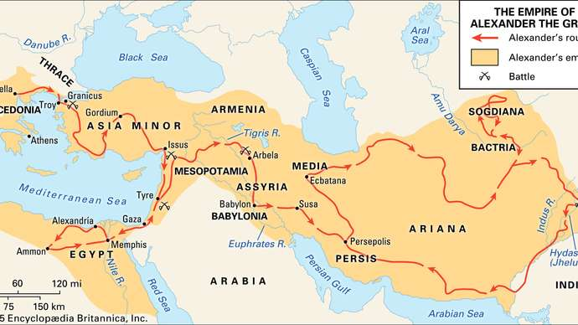
Alexander the Great (356 BCE-323 BCE)
Notes:
The spiritual tradition of devotion to Ahura Mazda was severely threatened by the 331 bce invasion of Alexander, known as “the Great” in the West but “the Accursed” in Iran. According to Zoroastrian belief, he ransacked the beautiful capital of Persepolis, destroying fire temples, burning the library containing the holy scriptures of Zarathushtra, and killing so many Zoroastrian priests that oral transmission of many scriptures was also lost. It is thought that the Gathas of Zarathushtra survived because many people knew them by heart, as they did the most commonly used ritual prayers.

Slide 19
7A.2 Spread of Zoroastrian beliefs
After severe persecution subsequent to Alexander’s invasion in 331 BCE, Zoroastrianism was reestablished in Persia by the Parthians in the first century BCE and became a state religion under the Sassanids.
The surviving teachings of the faith were reassembled as the Avesta or holy texts.

Slide 20
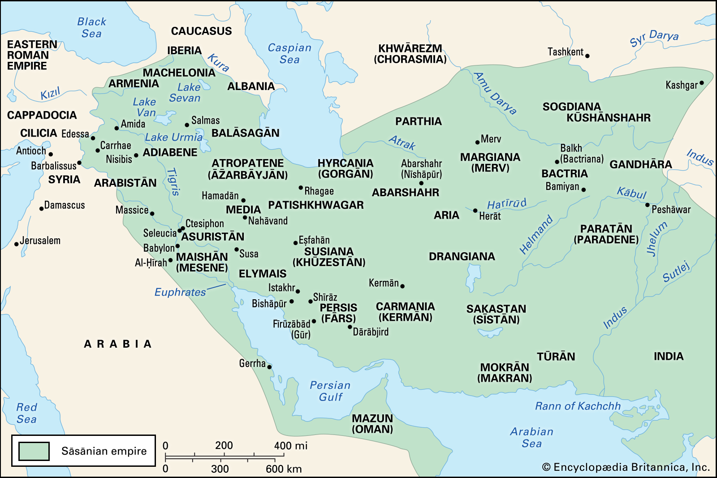
Sasanian Empire (226-651 CE)

Slide 21
Spread of Zoroastrian beliefs (2 of 2)
Threatened by the invasion of Alexander (331 CE)
Parthians compiled the Avesta, or “holy texts”
Sassanids (third to seventh centuries CE) adopted Zoroastrianism as state religion
Threatened by spread of Islam
Many Persians (called Parsis) immigrated to India
Pahlavi texts: detailed instructions about rituals and customs from ninth century
Notes:
However, a major threat to Zoroastrianism came from the spread of Islam after the death of Muhammad in 632 ce. Arabic Muslims defeated the Zoroastrian Iranian forces, and when Mongols invaded from the east they were gradually converted to Islam rather than Zoroastrianism. A number of Persian Zoroastrians avoided conversion to Islam by migrating to western India, whose spiritual origins were similar to their own. In India they were called Parsis (Persians). The sacred fire they consecrated on reaching India is said to have been kept burning continuously ever since. Some Parsis also migrated to what is now Pakistan. The numbers of Zoroastrians remaining in Iran dwindled over the centuries
under Muslim dominance. Even when Zoroastrians had become a minority in Iran, detailed instructions about the rituals and customs of the faith were preserved in a vast new literature, the Pahlavi texts, written or translated in Middle Persian from about the ninth century ce. A small community of believers still survives in Iran.

Slide 22
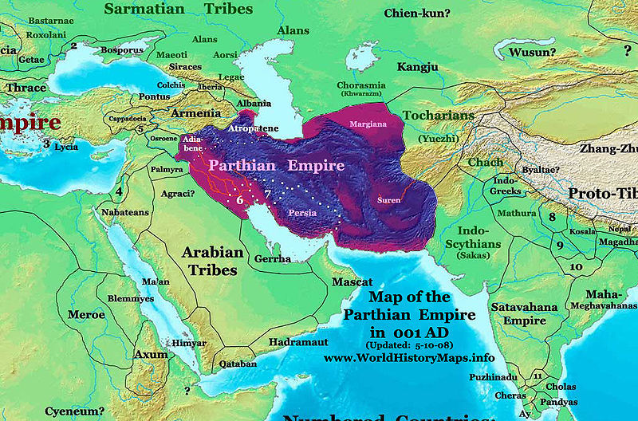
Parthian Empire (Arsacid Empire) 247 BC to 224 AD

Slide 23
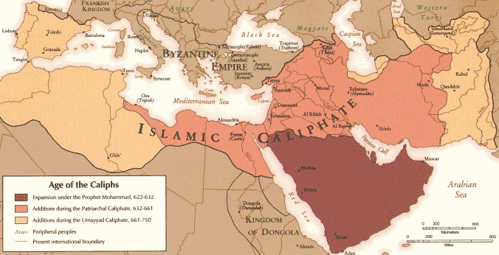
Age of Caliphs

Slide 24
7A.2 Spread of Zoroastrian beliefs
The rise of Islam threatened Zoroastrianism, and many Zoroastrians fled to western India, where their descendants are now known as the Parsis.
A small number of Zoroastrians remaining in Persia preserved a new literature known as the Pahlavi texts, detailing ritual and custom.
Today, India—especially the Mumbai (Bombay) area—is the major center of Zoroastrian population; practices have been affected by Hinduism and other surrounding religious traditions.

Slide 25
7A.3 Zoroastrian teachings The primacy of Ahura Mazda
Zarathushtra is considered the first of the monotheists of the Western traditions.
He refers to this god, Ahura Mazda, by the masculine gender.

Slide 26
7A.3 Zoroastrian teachings The primacy of Ahura Mazda
Though Ahura Mazda is the one Eternal Being, Zarathushtra also described six divine powers, called Holy Immortals or Ameshta Spenta, as radiating from the godhead:
The Good Mind,
Righteousness,
Absolute Power,
Devotion,
Perfection,
Immortality.

Slide 27
7A.3 Zoroastrian teachings The primacy of Ahura Mazda
These Holy Immortals were described as luminous deities with shining eyes and beautiful forms who held celestial counsel in the heavens and descended to earth on radiant paths.
They are chief among angels and guard light, truth, and wealth.

Slide 28
7A.3 Zoroastrian teachings The choice between good and evil
Zarathustra wrestled with the problem of evil.
There is scholarly debate over whether Zarathustra taught a cosmic dualism or whether this is a later development in the religious system.
In any case, Ahura Mazda is believed to be the supreme good creator, who creates only perfection and purity.

Slide 29
7A.3 Zoroastrian teachings The choice between good and evil
Yet, there are two opposing powers: Spenta Mainyu (good) and Angra Mainyu (evil).
These two powers challenge human free will and mental capacity to choose between them.

Slide 30
The choice between good and evil
Western scholars:
Cosmic dualism: the struggle between good and evil
Later development?
Zoroastrian belief Ahura Mazda is a good creator who creates only perfection and purity.
Two opposing powers:
Spenta Mainya, the good spirit
Life, order, perfection, health, happiness, increase
Angra Mainyu, the evil spirit
not-life, chaos, imperfection, disease, sorrow, destruction
Nonloving acts in name of religion aid evil
Notes:
Zarathushtra wrestled with the problem of the existence of evil. Many Western scholars describe Zarathushtra’s theology as cosmic dualism, with Ahura Mazda opposed by a dark force of equal power. Others feel that this is a later development in Zoroastrianism and that the original teaching was that although there were two opposing forces in the universe, Ahura Mazda was much the stronger. In any case, in Zoroastrian belief Ahura Mazda is a good creator who creates only perfection and purity.
The two principles will always actively oppose each other in humans and in creation as a whole until the good spirit is at last victorious. Evil, Zarathushtra asserts, is not all-powerful or eternal, but to assure the victory of good over evil humans must dedicate themselves as spiritual warriors on the side of Spenta Mainyu. Human beings are given the free will and mental capacity to choose between the two powers. In their thoughts, words, and deeds, they can grow in love, devotion, and service, or they can contribute to evil.
Zarathushtra felt that nonloving acts in the name of religion aided the cause of evil. He railed against selfish ritualism and worship of the daevas, using the old word for the “shining deities” for what he considered dark forces and magic.

Slide 31
7A.3 Zoroastrian teachings Heaven, hell, and resurrection
In Zoroastrian belief, each person is judged at death according to the total goodness or evilness of our thoughts, deeds, and words.
Ahura Mazda is not the judge of rewards and merits; rather, by natural law, good deeds bring their own reward and evil deeds bring just punishment.

Slide 32
7A.3 Zoroastrian teachings Heaven, hell, and resurrection
The greater the goodness, the wider the bridge that leads to heaven; the greater the evil, the narrower the bridge.
Hell is considered to be a woeful, murky place. However, the world can reach a state of perfection with the help of those individuals who choose good over evil. All souls will eventually be liberated from evil.
Moral responsibility of each person is emphasized.

Slide 33
7A.3 Zoroastrian teachings Religious practices
Rituals are a major part of Zoroastrian practice, especially purification rituals involving water or fire.
Other rituals focus on purification.
Rituals are performed at fire temples.
At death, bodies are taken to Towers of Silence, where vultures eat the remains.
The near-extinction of vultures in India has caused a crisis for this traditional practice.
Zoroastrians offer prayers for the dead and observe death anniversaries

Slide 34
Zarathushtra’s Mission
Ahura Mazda was surrounded by angelic presences manifesting six attributes of the divine
Scholars suggest that these attributes represent earlier Indo-Iranian deities, transformed by Zarathushtra to suit his monotheistic belief but still retaining their association with forces of nature—the earth, the arch of the sky, water, plants, cattle, and fire
Cosmic battle between good and evil
Adopted as state religion by King Vishtapa
Asura – demon in Indian languages
Daeva – demon in Iranian languages
Deva or Devi – god or goddess in Indian languages
Notes:
Zarathushtra said he experienced communion with Ahura Mazda and his attributes on many occasions. From these direct contacts with the divine, Zarathushtra reportedly determined that in contrast to the multiplicity of gods worshiped by the Indo-Iranians, Ahura Mazda was the wise Lord, from whom all good things flowed. Zarathushtra denounced all cruelty, selfishness, distortion, and hypocrisy in the name of religion. He insisted that Ahura Mazda creates only goodness and should be worshiped by good thoughts, words, and deeds. There is a cosmic battle between sustaining and destroying forces, and to assure the victory of good over evil, humans must dedicate themselves as spiritual warriors for goodness

Slide 35
7A.4 Zoroastrianism today
There are very few practitioners of Zoroastrianism today, which threatens this ancient religion.
For example, a Zoroastrian holy flame has been burning continuously for 1,500 years in Iran, but there are not enough devotees to keep the Tower of Silence open.
However, there is renewed interest in study and preservation of Zoroastrian texts and traditions.
Such efforts have brought a renewed sense of pride and appreciation within Zoroastrianism.

Slide 36
The primacy of Ahura Mazda
Ameshta Spenta: Holy Immortals, personification of six divine attributes:
The Good Mind
Righteousness
Absolute Power
Devotion
Perfection
Immortality
personified and worshiped as deities after Zarathushtra’s death.
Notes:
hese Holy Immortals, the Ameshta Spenta, were described as luminous deities with shining eyes and beautiful forms, guardians of Ahura Mazda’s creation who held celestial councils in the heavens and descended to earth on radiant paths. They are chief among the angels, who also include many of the deities worshiped by the earlier Iranians. One of these is the popular Mithra, guardian of the light, protector of the truth, and bestower of wealth.

Slide 37
Heaven, hell, and resurrection
Each person will be judged according to goodness and evilness
Greater the good, the wider the bridge to heaven
Greater the evil, the narrower the bridge to heaven
Fall into hell, House of Lies
Punishment according to natural law
No eternal hell
Good is ultimately victorious
Frashokereti – the “refreshment” or renovation of the world in which all of creation is resurrected into perfected immortality and in perfect unity with Ahura Mazda
Notes:
Zoroastrians feel that the effects of our actions will be felt both in the present and in an afterlife
There is no eternal hell in Zoroastrianism, for good is ultimately victorious.
With the help of all individuals who choose goodness over evil, the world will gradually reach a state of perfection in which all souls, living or dead, are liberated forever from evil. This time is the Frashokereti, the “refreshment” of the world in which all of creation is resurrected into perfected immortality. Thenceforth the world will never grow old and never die. This refreshment requires the contributions of many people. Zoroastrianism therefore places great emphasis on the moral responsibility of each person, for the good of the whole

Slide 38
Religious practices
Sacred cord (kusti) tied five times a day recite a prayer to keep evil at bay
Worn by both males and females
Purity emphasized.
Water: symbol for purification
Notes:
Rituals are major elements of Zoroastrian practice. One that is particularly important is the act of tying the sacred cord (kusti) around one’s mid-section, traditionally performed at least five times a day. Symbolically, the faithful are girding themselves as soldiers for Ahura Mazda, strengthening their resolve to follow the spiritual path. The kusti is worn by both males and females, in contrast with the male-only Hindu tradition of the sacred thread, for women and men are treated equally in many ways within Zoroastrianism. While tying the kusti, the faithful recite a prayer to keep evil at bay. Zoroastrian rituals also emphasize purification. Water is venerated as a means or symbol of purification. The devout will often dip their fingers into water, apply it to their eyes and forehead, and raise their hands in prayer to Ahura Mazda. It is a great sin to pollute water or to place anything dead in it. Zoroastrians regard the natural world with profound reverence and are taught from childhood to avoid defiling it.

Slide 39
Religious practices
Fire ritual central
Funerary rites in a Tower of Silence
Vultures pick bones clean
fravashi: eternal principle and guide or eternal principle and guide, of the deceased person is invoked. The fravashi is thought to continually evolve toward perfection and to help the living in their good works.
Notes:
Rituals are major elements of Zoroastrian practice. One that is particularly important is the act of tying the sacred cord (kusti) around one’s mid-section, traditionally performed at least five times a day. Symbolically, the faithful are girding themselves as soldiers for Ahura Mazda, strengthening their resolve to follow the spiritual path. The kusti is worn by both males and females, in contrast with the male-only Hindu tradition of the sacred thread, for women and men are treated equally in many ways within Zoroastrianism. While tying the kusti, the faithful recite a prayer to keep evil at bay. Zoroastrian rituals also emphasize purification. Water is venerated as a means or symbol of purification. The devout will often dip their fingers into water, apply it to their eyes and forehead, and raise their hands in prayer to Ahura Mazda. It is a great sin to pollute water or to place anything dead in it. Zoroastrians regard the natural world with profound reverence and are taught from childhood to avoid defiling it.

Slide 40
Zoroastrianism today
North American Zoroastrians emphasize conversion.
In 2003, the Parsi community declared that anyone marrying outside the religion would be excommunicated.
Some now pray in English instead of ancient Avestan language.
“Return to Roots”: youth movement that supports Zoroastrian identity around the world
Notes:
When the Parsis were influenced by Westernization and Protestant missionary activity, they became somewhat embarrassed about the mystical aspects of their faith. Some began reciting their prayers in English rather than the ancient Avestan language, and interpreting what they were doing as talking to God rather than uttering powerful sacred mantras. They tended to de-emphasize rituals and beliefs in an evil spirit and the end of the temporal world in favor of the more abstract philosophy and ethical standards of the Gathas. The pendulum now seems to be swinging in the other direction. Training is still available in Iran and India for the hereditary lineage of Zoroastrian priests, and there is now considerable interest in preserving and understanding the tradition. Religious historians, metaphysicians, and linguists have attempted to translate the ancient language, uncover the deep significance behind the rituals, and sift out the origins of the tradition from the thousands of years of later accretions. A program called “Return to Roots” seeks to strengthen Zoroastrian youth identity around the world, sponsoring visits to important sites in India. Such efforts have brought a renewed sense of pride and appreciation within Zoroastrianism.

Slide 41
Zoroastrianism today
Some Zoroastrians in North America favor active conversion of non-Zoroastrians to the faith; others are opposed to proselytizing but favor the acceptance of those who are truly moved by personal religious experience.
Notes:
When the Parsis were influenced by Westernization and Protestant missionary activity, they became somewhat embarrassed about the mystical aspects of their faith. Some began reciting their prayers in English rather than the ancient Avestan language, and interpreting what they were doing as talking to God rather than uttering powerful sacred mantras. They tended to de-emphasize rituals and beliefs in an evil spirit and the end of the temporal world in favor of the more abstract philosophy and ethical standards of the Gathas. The pendulum now seems to be swinging in the other direction. Training is still available in Iran and India for the hereditary lineage of Zoroastrian priests, and there is now considerable interest in preserving and understanding the tradition. Religious historians, metaphysicians, and linguists have attempted to translate the ancient language, uncover the deep significance behind the rituals, and sift out the origins of the tradition from the thousands of years of later accretions. A program called “Return to Roots” seeks to strengthen Zoroastrian youth identity around the world, sponsoring visits to important sites in India. Such efforts have brought a renewed sense of pride and appreciation within Zoroastrianism.

Slide 42
Zoroastrianism today
In India, the high priests of the Mumbai Zoroastrian community declared in 2003 that anyone marrying outside the religion would be excommunicated, but this brought such an outcry that they clarified that their statement was only a “guideline” to assure the survival of the Parsi faith.
However, late marriage, low birth rates, and divorce remain concerns as the Parsi population continues to decline.
Notes:
When the Parsis were influenced by Westernization and Protestant missionary activity, they became somewhat embarrassed about the mystical aspects of their faith. Some began reciting their prayers in English rather than the ancient Avestan language, and interpreting what they were doing as talking to God rather than uttering powerful sacred mantras. They tended to de-emphasize rituals and beliefs in an evil spirit and the end of the temporal world in favor of the more abstract philosophy and ethical standards of the Gathas. The pendulum now seems to be swinging in the other direction. Training is still available in Iran and India for the hereditary lineage of Zoroastrian priests, and there is now considerable interest in preserving and understanding the tradition. Religious historians, metaphysicians, and linguists have attempted to translate the ancient language, uncover the deep significance behind the rituals, and sift out the origins of the tradition from the thousands of years of later accretions. A program called “Return to Roots” seeks to strengthen Zoroastrian youth identity around the world, sponsoring visits to important sites in India. Such efforts have brought a renewed sense of pride and appreciation within Zoroastrianism.

Slide 43
Zoroastrianism today
When the Parsis were influenced by Westernization and Protestant missionary activity, they became somewhat embarrassed about the mystical aspects of their faith.
Some began reciting their prayers in English rather than the ancient Avestan language, and interpreting what they were doing as talking to God rather than uttering powerful sacred mantras.
Notes:
When the Parsis were influenced by Westernization and Protestant missionary activity, they became somewhat embarrassed about the mystical aspects of their faith. Some began reciting their prayers in English rather than the ancient Avestan language, and interpreting what they were doing as talking to God rather than uttering powerful sacred mantras. They tended to de-emphasize rituals and beliefs in an evil spirit and the end of the temporal world in favor of the more abstract philosophy and ethical standards of the Gathas. The pendulum now seems to be swinging in the other direction. Training is still available in Iran and India for the hereditary lineage of Zoroastrian priests, and there is now considerable interest in preserving and understanding the tradition. Religious historians, metaphysicians, and linguists have attempted to translate the ancient language, uncover the deep significance behind the rituals, and sift out the origins of the tradition from the thousands of years of later accretions. A program called “Return to Roots” seeks to strengthen Zoroastrian youth identity around the world, sponsoring visits to important sites in India. Such efforts have brought a renewed sense of pride and appreciation within Zoroastrianism.

